Slide 1
ISOI XV
8 October 2015
The Spencer Hotel, Dublin, Ireland
Trident – Sharing is Scaring the Bad Guys
Jeroen Massar, Ops-Trust / Trident.li
jeroen@massar.ch
IPv6 Golden Networks

Slide 2
Jeroen’s Hats
Work:
Farsight Security (http://www.farsightsecurity.com)
Fun:
Ops-Trust (https://www.ops-trust.net)
Sysadmin – keeping it running smoothly
Trident Project (https://trident.li)
Design & Implementation
SixXS (https://www.sixxs.net)
IPv6 Deployment

Slide 3
Ops-Trust
As per https://openid.ops-trust.net/about:
“OPSEC-Trust (or "ops-trust") forum is a highly vetted community of security professionals focused on the operational robustness, integrity, and security of the Internet.”
Also known as “Ops-Trust” or just “Ops-T”.

Slide 4
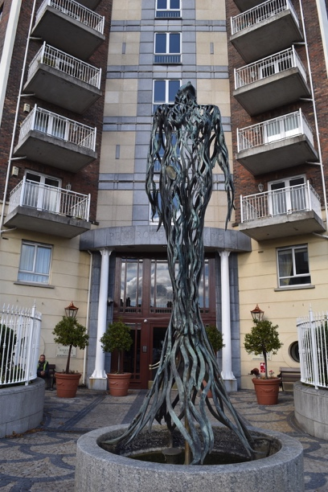
Ops-T Trust Groups
Initially started out with a single Trust-Group
Smaller TGs added for specific problems
Each TG has own purpose and policies
Being in one TG does not mean you are automatically in any other, or that you even know about them
Each Trust Group gets:
One or more mailinglists,
optional required PGP encryption
Wiki & Files area
Member Portal

Slide 5
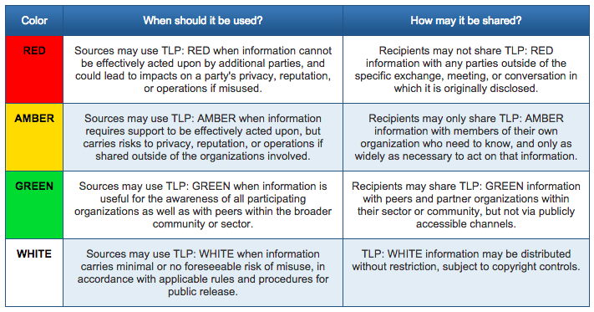
Trust!
The most important thing: Trust
If one person does something ‘wrong’ the ones who vouched the person are accountable
Unless specifically mentioned with Traffic Light Protocol indicators, communications must never leave the person who received it:
“All message content remains the property of the author and must not be forwarded or redistributed without explicit permission.”
https://www.us-cert.gov/tlp

Slide 6
Ops-Trust Code Base
Codebase:
Perl using Mason for “portal”, Open-ID uses Catalyst
External perl dependencies, many not in Debian packages
Database: PostgreSQL
Components:
PGP-remailer
Web-frontend “portal” for managing vouches, finding people
Open-ID for authenticating at external resources
Two Factor Authentication using HOTP/TOTP/SOTP
Foswiki as a Wiki (initially we used Confluence)
Open Source!
https://github.com/ops-trust/

Slide 7
Trident
Complete from-scratch rewrite in only Go (https://www.golang.org)
Only the PostgreSQL database schema survived
Focus on cleanliness and less work for sysadmin:
TG Admins have full control over their own TG.
Nothing ‘external’ (eg foswiki leaves ‘portal’ portion)
Simplified installation: Debian Package (will try to get it in Debian proper)
Simplified upgrades: tridentd knows how to upgrade DB
Open Source: Apache License
Multi-host support (multiple tridentd’s) for load balancing and failover (work is scheduled using PostgreSQL)

Slide 8
Trident - Backend
Daemon (tridentd) that serves HTTP, fronted by nginx
Command Line (Tickly / tcli) enables full control
WebUI/CLI feature parity: just with pretty buttons
HTTP API which equals the CLI, as it is the CLI
Integrated OAuth2 / Open-ID Connect support
Also used for CLI authentication
Uses JSON Web Token (JWT) for authentication thus allowing easier automation

Slide 9
Trident - Frontend
Bread > Crumbs > For > Easy > Navigation
Two Factor Authentication using HOTP/TOTP/SOTP
Mobile-aware (resizes to fit your screen using CSS)
Integrated Wiki based on EpicEditor, BlueMonday + BlackFriday: thus ‘standard’ github flavored markdown
SQL-based and cachable thus much faster than Foswiki
Pretty with CSS, no javascript needed (only for pretty wiki editor)
File upload/downloads/management
Calendaring with CalDAV support for Events
http://www.epiceditor.com
https://github.com/microcosm-cc/bluemonday
https://github.com/russross/blackfriday

Slide 10
Trident - Mail
PGP-remailer is integrated and supports queuing internally thus can see status of delivery of a message
Outbound bounce handling handled directly, thus can better inform a TG admin of problems with delivery of mail to a member
Handles lists with >10k members much better, if one needs more capacity, just add another node
LMTP instead of forwarding, thus no more DSN for inbound mail (DSN is “delivery status notification” aka bounce)

Slide 11
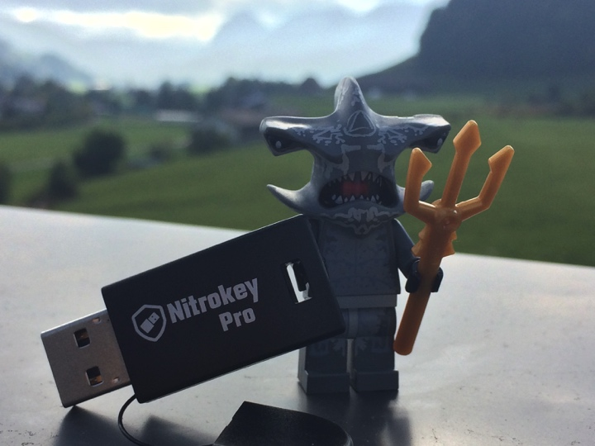
Auth Token Support
Implemented:
TOTP - Time-based One-Time Password
HOTP - HMAC-based OTP
SOTP - Single-use OTP
Tools:
Google Authenticator (Android/IOS)
Nitrokey [also pgp]
https://www.nitrokey.com
Open Source Hardware & Software
Yubikey [also pgp]
Planned
FIDO U2F (https://fidoalliance.org/)

Slide 12
Your Own Instance
Don’t trust Ops-T sysadmin? (eg, do you trust me? :)
Want to keep data local?
Want your own Secret Fight Club?
Then soon you’ll be able to install your own instance.
Debian packages are already being generated and used for a couple of beta instances with >1000 active users.
Code soon on: http://github.com/tridentli
Watch the announcements on https://twitter.com/tridentli/

Slide 13
Future Features
“Home page” like on your favorite social network with latest contributions & changes
Visualized Trust Graphs
Jabber + RobustIRC integration
Mail to web, thus being able to read list as a forum and contribute using the webinterface
Federation: profile sharing with other Trident instances
FreeBSD Package

Slide 14
What do you miss?
Integration?
MISP – Malware Information Sharing Platform
(http://www.misp-project.org)
CIF – Collective Intelligence Framework
(https://github.com/collectiveintel/cif-v1)
others?
Workflow
“Tickets?”
ASN / IP-lists / notes?

Slide 15
Questions?
Jeroen Massar
jeroen@massar.ch
https://trident.li / project@trident.li
PGP: 0x123421B735578C46
(some screenshots are after this slide)

Slide 16
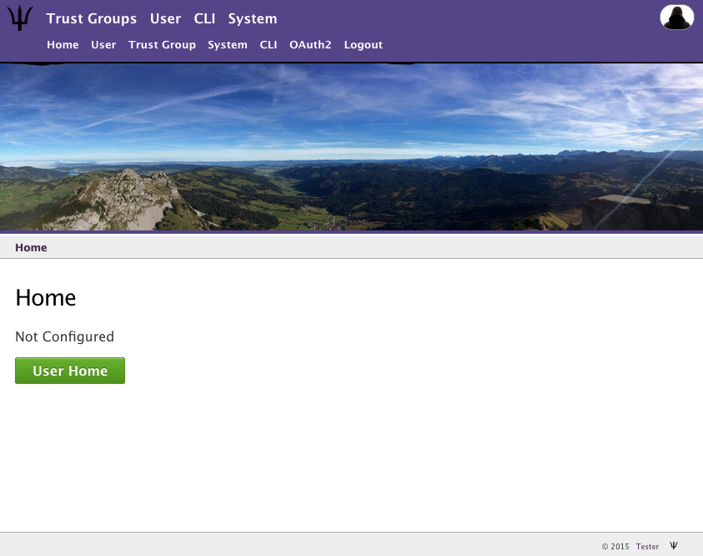

Slide 17
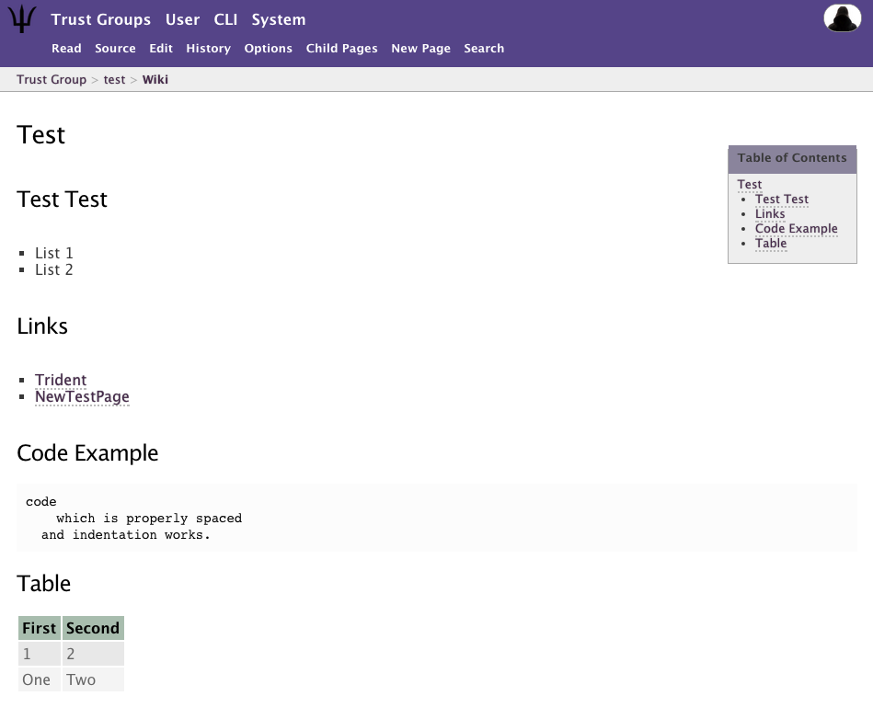

Slide 18
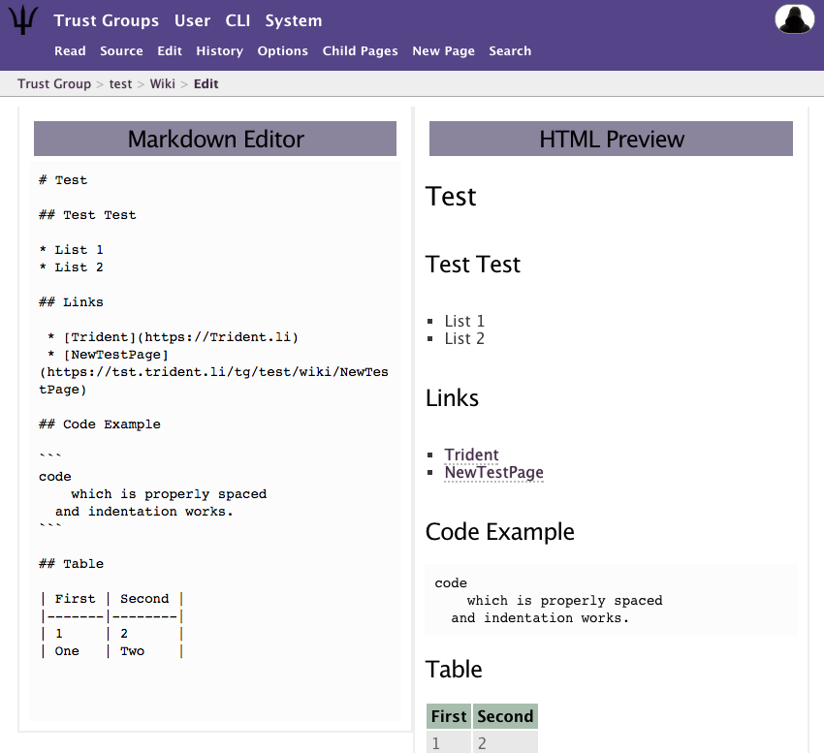
Trident Wiki Edit

Slide 19
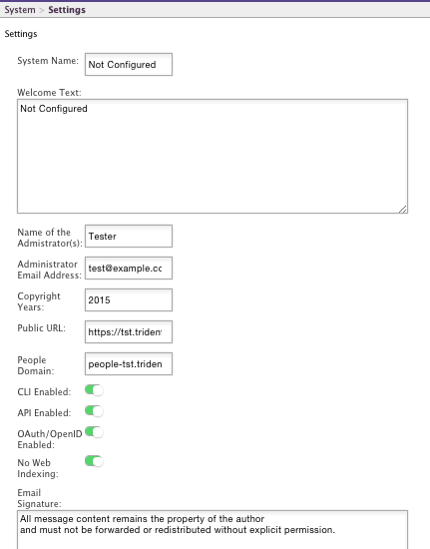
Screenshot (n)

Slide 20
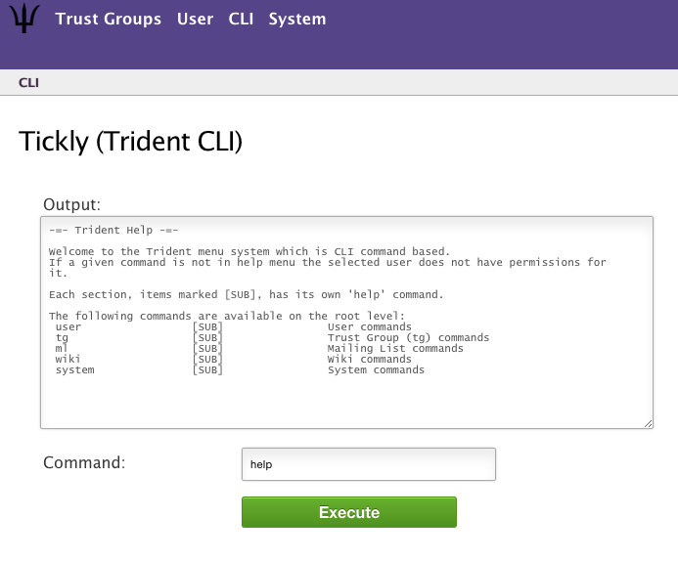
Screenshot (n)

